Slide 1

Lecture 35
DATA 8
Spring 2023
Classifiers

Slide 2
Nearest Neighbors

Slide 3
Finding the k Nearest Neighbors
To find the k nearest neighbors of an example:
Find the distance between the example and each example in the training set
Augment the training data table with a column containing all the distances
Sort the augmented table in increasing order of the distances
Take the top k rows of the sorted table

Slide 4
The Classifier
To classify a point:
Find its k nearest neighbors
Take a majority vote of the k nearest neighbors to see which of the two classes appears more often
Assign the point the class that wins the majority vote
(Demo)

Slide 5
Evaluation

Slide 6
Accuracy of a Classifier
The accuracy of a classifier on a labeled data set is the proportion of examples that are labeled correctly.
Need to compare classifier predictions to true labels. If the labeled data set is sampled at random from a
population, then we can infer accuracy on that population.
Sample | Labels
Training
Set
Test Set
(Demo)

Slide 7
Before Classifying

Slide 8
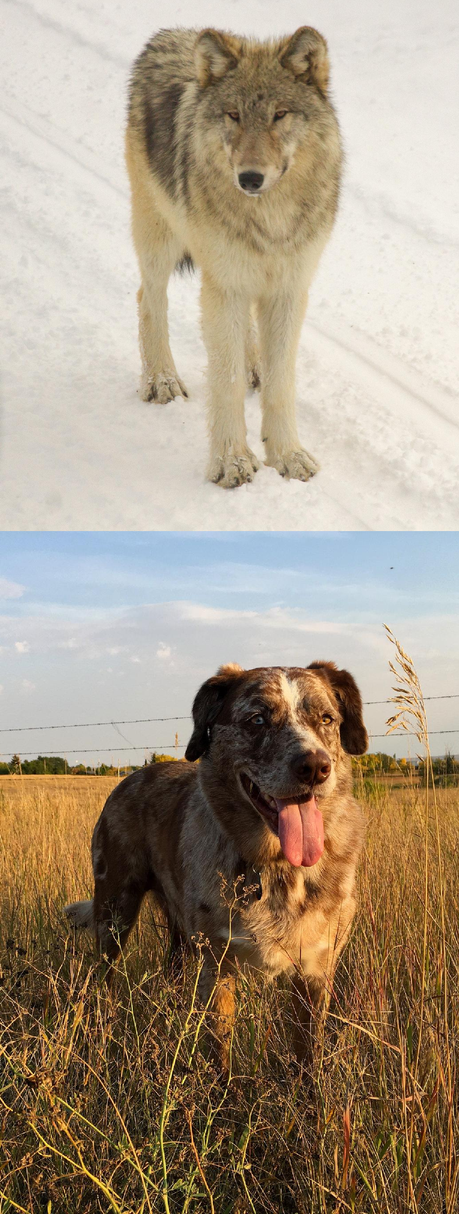

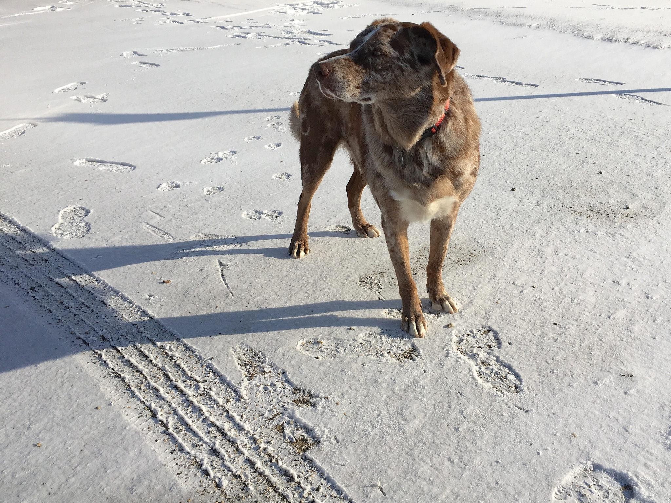
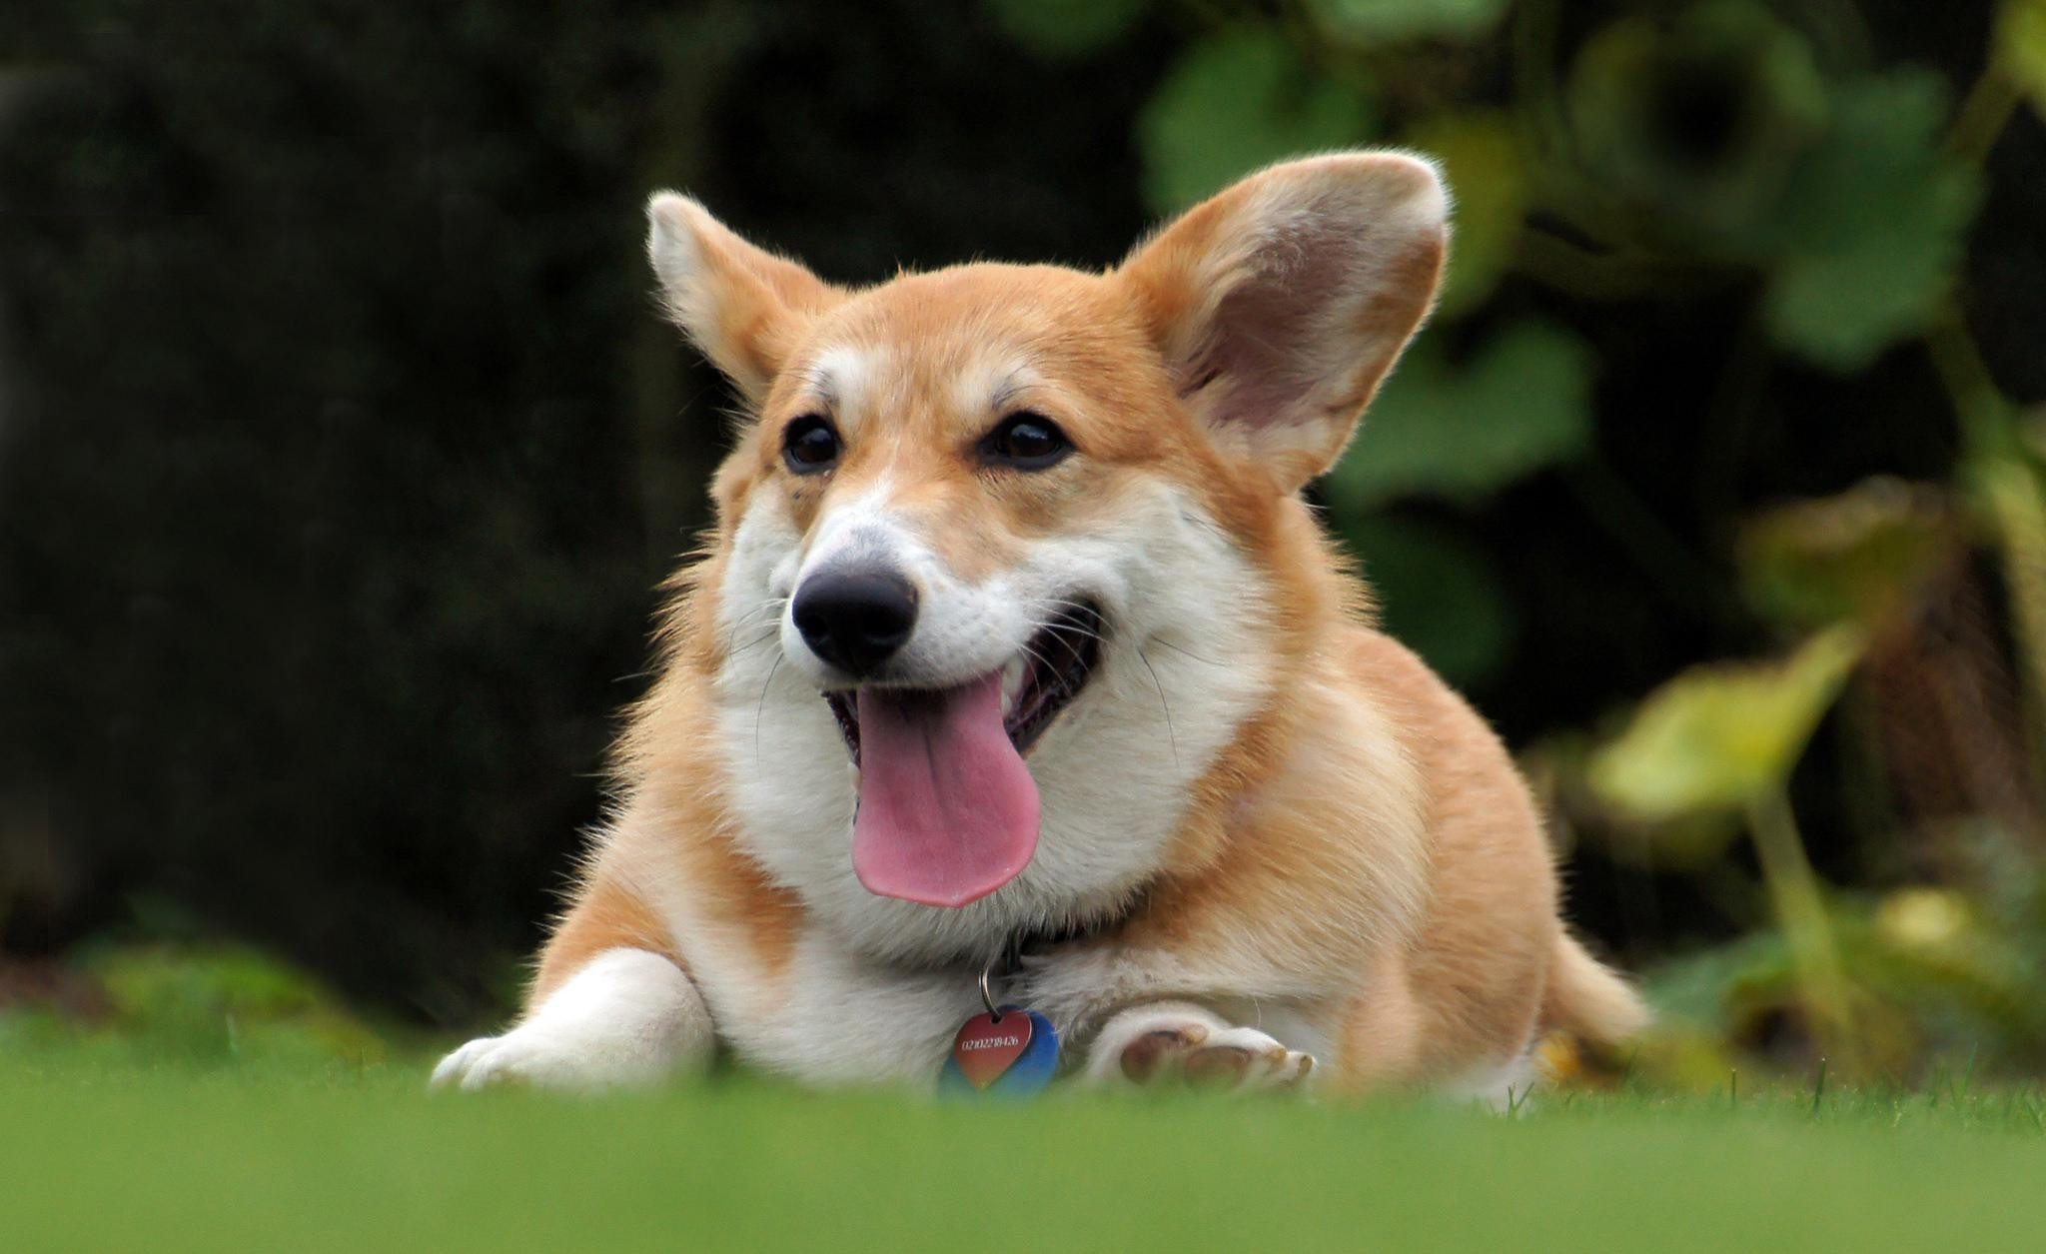
Dog or Wolf?

Slide 9
Start with a Representative Sample
Both the training and test sets must accurately represent the population on which you use your classifier
Overfitting happens when a classifier does very well on the training set, but can’t do as well on the test set

Slide 10
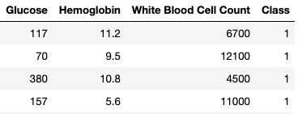
Standardize if Necessary
Chronic Kidney Disease data set
If the attributes are on very different numerical scales, distance can be affected
In such a situation, it is a good idea to convert all the
variables to standard units
(Demo)

